Slide 1
Software Architecture Patterns & Styles
System Design Fundamentals - Architectural Patterns

Slide 2
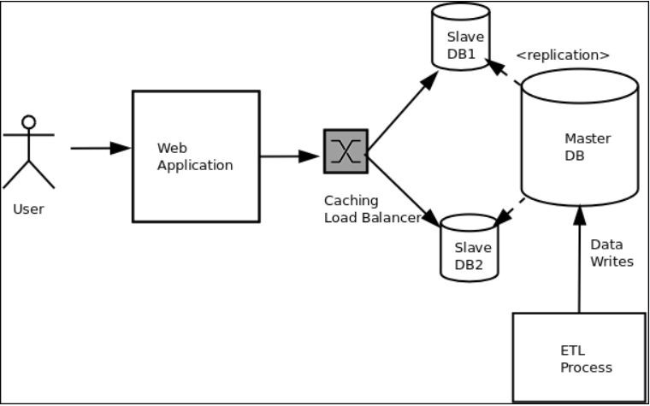
What is Software Architecture?
Deﬁnition: The high-level structure of a software system, deﬁning components, their relationships, and the way they interact.
Why It Matters: It impacts
scalability, maintainability, performance, and system behavior.
Common Architectural Styles
  Monolithic
  Layered (N-tier)
  Client-Server
  Microservices
  Event-Driven

Slide 3
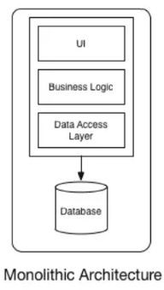
Monolithic Architecture
Deﬁnition: A single uniﬁed system where all components are tightly coupled and work as a single unit.
Pros:
  Simple to develop and deploy.
  Easier to manage in smaller applications.
Cons:
  Hard to scale.
  Diﬃcult to maintain as the codebase grows.
  High risk of failure: A single bug can take down the entire system.
Use Cases: Small-scale applications, startups,
simple CRUD-based apps.

Slide 4
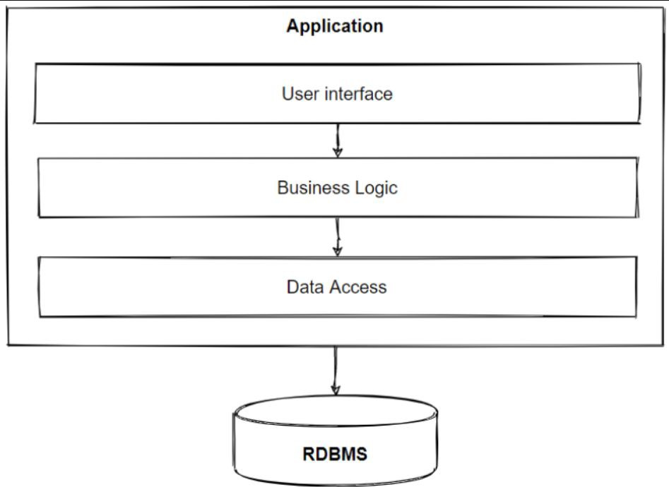
Layered (N-Tier) Architecture
Deﬁnition: A system split into multiple layers (e.g., Presentation, Business Logic, Data) to separate concerns.
Pros:
  Clear separation of concerns.
  Easier to scale and maintain compared to monolithic.
Cons:
  Performance overhead due to layers.
  May result in tight coupling between certain layers.
Use Cases: Enterprise applications, CRM
systems, Banking applications.

Slide 5
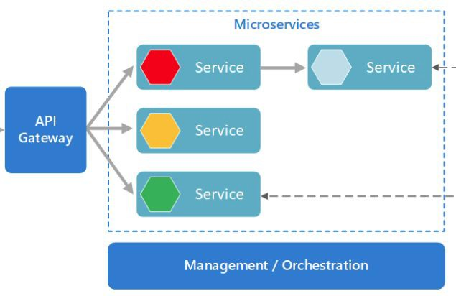
Microservices Architecture
Deﬁnition: A system built as a collection of small, independent services, each focused on a speciﬁc business capability.
Pros:
  Independent services can be scaled, deployed, and developed separately.
  Flexibility in technology stack for each service.
  Better fault tolerance.
Cons:
  Increased complexity in communication and coordination.
  Need for robust DevOps and automation pipelines.
Use Cases: Large-scale applications, e-commerce platforms, modern cloud-based systems.

Slide 6
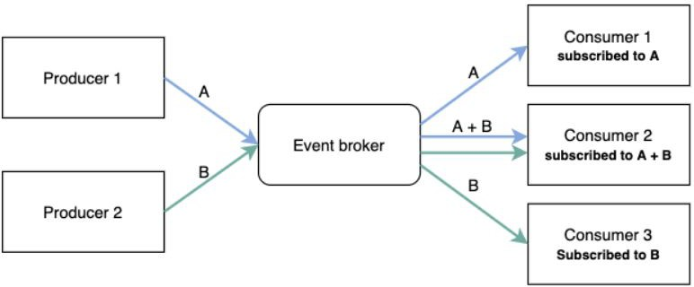
Event-Driven Architecture
Deﬁnition: A system where components communicate through events (messages) instead of direct calls, enabling loose coupling.
Pros:
  Highly decoupled architecture.
  Excellent for handling asynchronous workﬂows.
  Better scalability for high-traﬃc systems.
Cons:
  Debugging and tracing become more complex.
  Diﬃcult to ensure data consistency across services.
Use Cases: Real-time systems, IoT applications, ﬁnancial trading platforms.

Slide 7
Factors Inﬂuencing Architecture Selection
Business Needs: What problem are we solving? What is the business goal?
Scalability: How much traﬃc and data should the system handle?
Performance: How fast should the system respond to users?
Maintainability: How easy is it to make updates, ﬁx bugs, and evolve the system over time?

Slide 8
Interview questions
What is the diﬀerence between Monolithic and Microservices architecture?
When would you choose a Layered architecture over Microservices?
What are the pros and cons of Event-Driven Architecture?
How does architecture impact system scalability and performance?
How do business requirements inﬂuence architectural decisions?
Can you explain the key diﬀerences between Layered and Client-Server architectures?
What are the main challenges in maintaining a Monolithic system as it grows?
How do you decide between Monolithic and Microservices for a new system?
What role does fault tolerance play in Microservices architecture?
How do event-driven systems handle real-time data?

Slide 9
Summary & Key Takeaways
Understand diﬀerent architectural styles: Monolithic, Layered, Client-Server, Microservices, Event-Driven.
Each style has its pros, cons, and best-use cases.
Architecture decisions impact scalability, performance, maintainability, and system behavior.
Choose architecture based on business needs, technical requirements, and scalability goals.
Whats next:
  Multi-Tier Architecture

